Slide 1

Nearest Neighbors

Slide 2
Course Syllabus
Math 628:
Instructor : Ali Nazari
PhD Electrical Engineering ( University of Michigan)
MSc in Applied Mathematics
MSc in Financial Engineering
Head of Deep Learning @ Susquehanna
anazari@umich.edu
Grading:
2 Homeworks
2 Quizzes
Midterm exam
Final Project ( group of 3 students)
Code, report, and 30 minutes presentation

Slide 3
Course Syllabus
Nearest Neighbor Classification and Regression
Curse of Dimensionality
Decision-tree based models
Ensembles (Bagging, Boosting)
Random Forest, Gradient Boosting, Adaboost, LightGBM
Linear Models ( Regression, Classification)
Linear Regression
Linear Classification (Logistic Regression)
Learning (Perceptron, Gradient Descent)
Regularization, Lasso, Ridge Regression
Support Vector Machines
Unsupervised learning
Dimensionality Reduction
Clustering
Some introduction of ML application in statistical quantitative finance
Random Matrix theory application in Covariance denoising
Hidden Markov Models and application in financial regime detection
Gaussian Mixture models
State Space models ( Kalman filtering) and how it is used in pairs trading type of strategies

Slide 4
Machine Learning
For many problems, it’s difficult to program the correct behavior by hand
Recognizing people and objects
Understanding human speech
Learning to play chess, poker, …
Machine learning approach: program an algorithm to automatically learn from data, or from experience
Some reasons you might want to use a learning algorithm:
Hard to code up a solution by hand ( vision, speech, learning)
The environment might change, and the system should be able to adapt to new environments (spam detection)
Typically, we are looking for a system to perform better than the human programmers

Slide 5
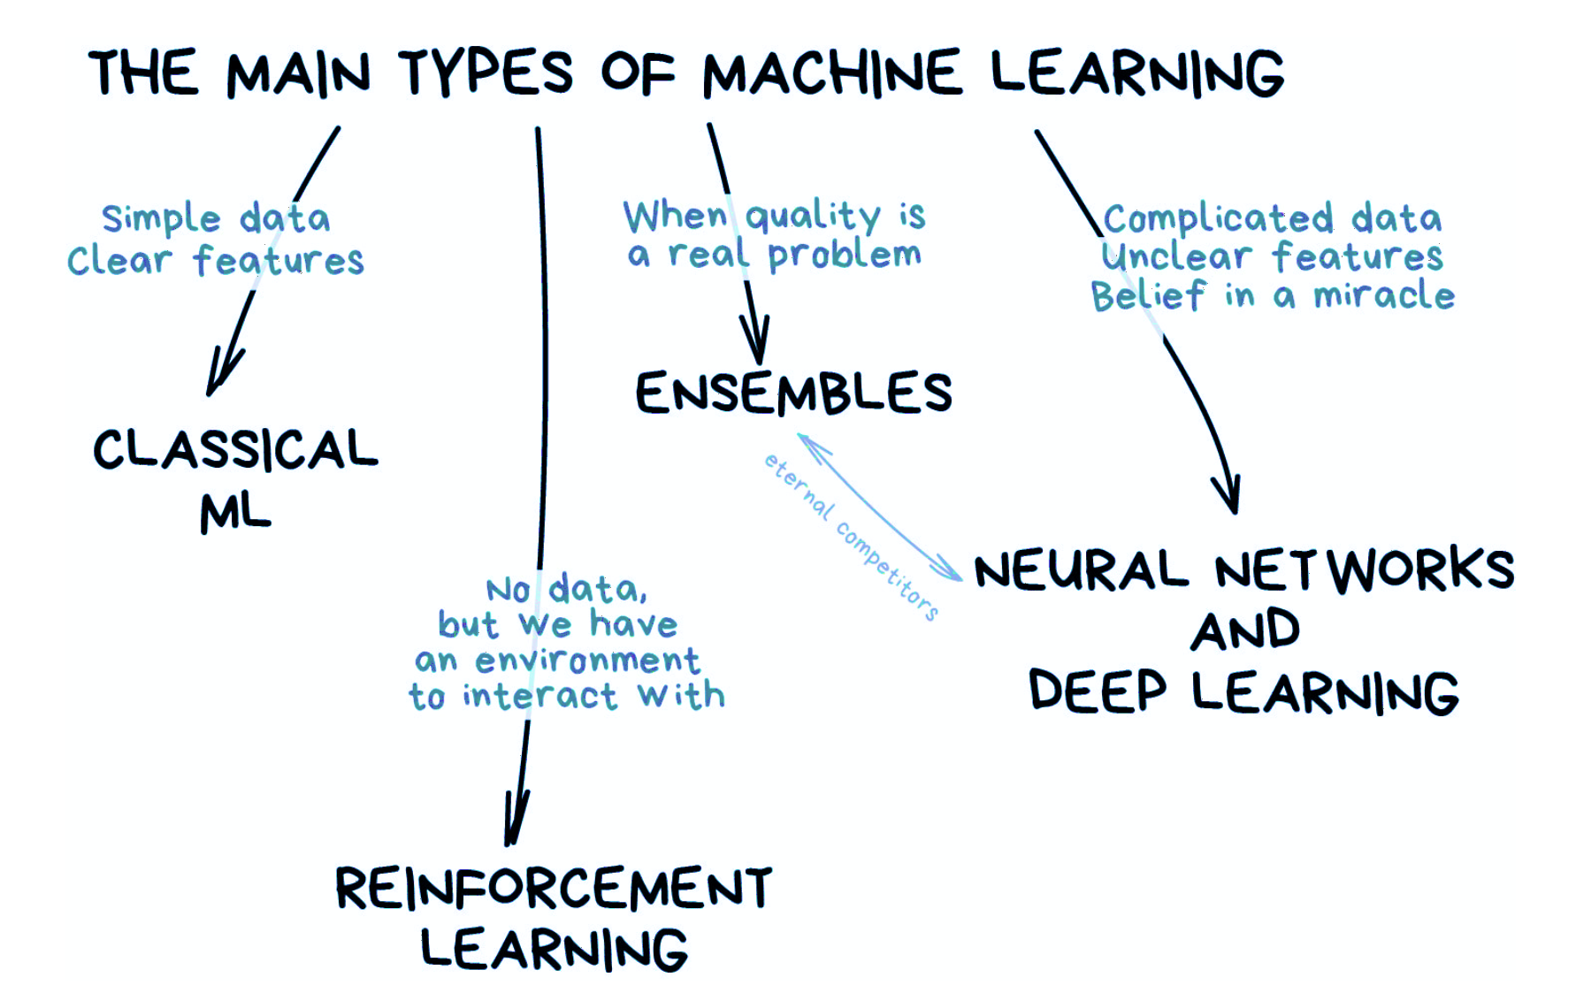
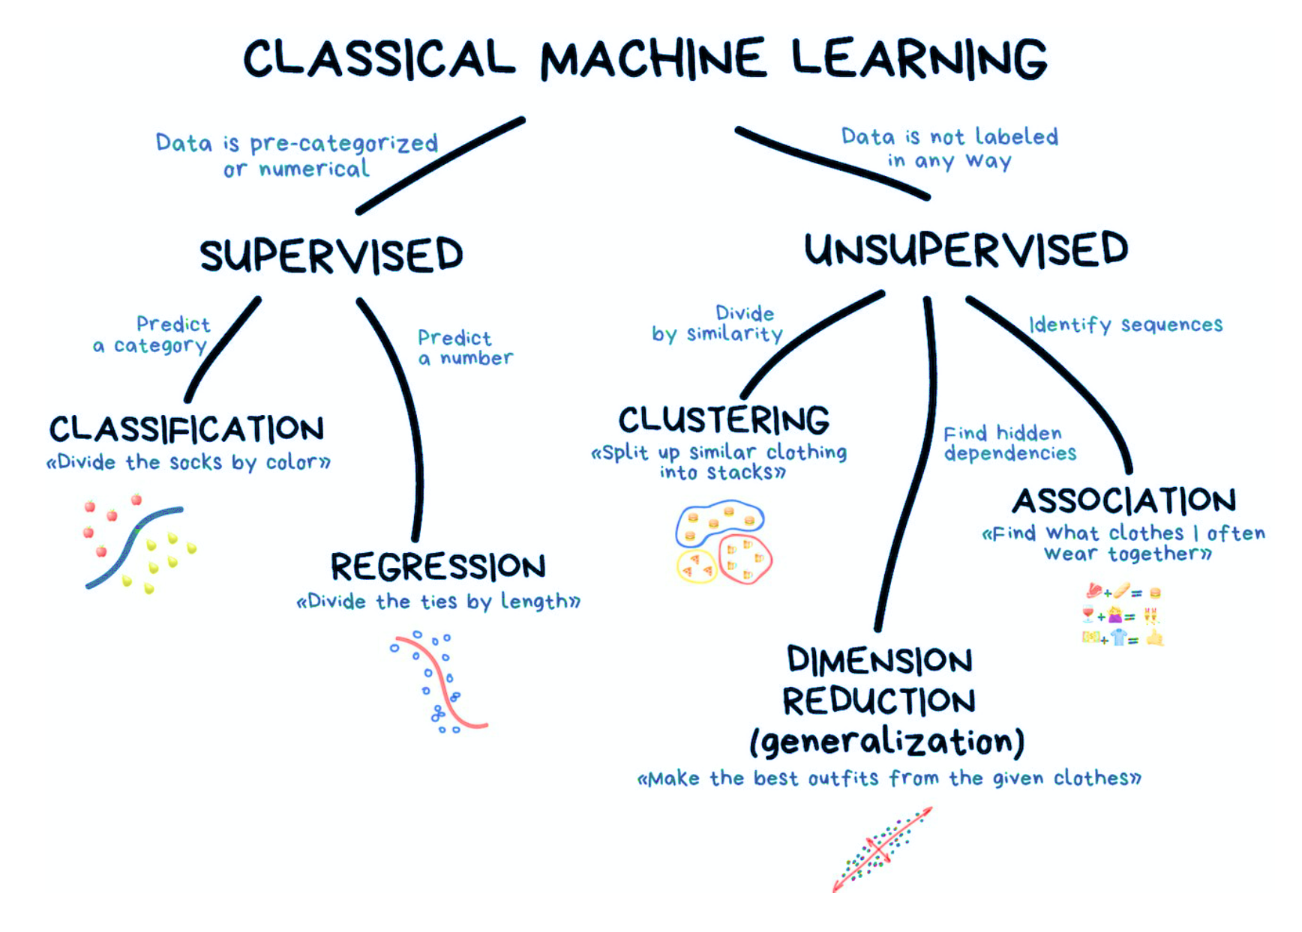
Machine Learning
Source: https://vas3k.com/blog/machine_learning/

Slide 6
Machine Learning
Source: https://vas3k.com/blog/machine_learning/

Slide 7
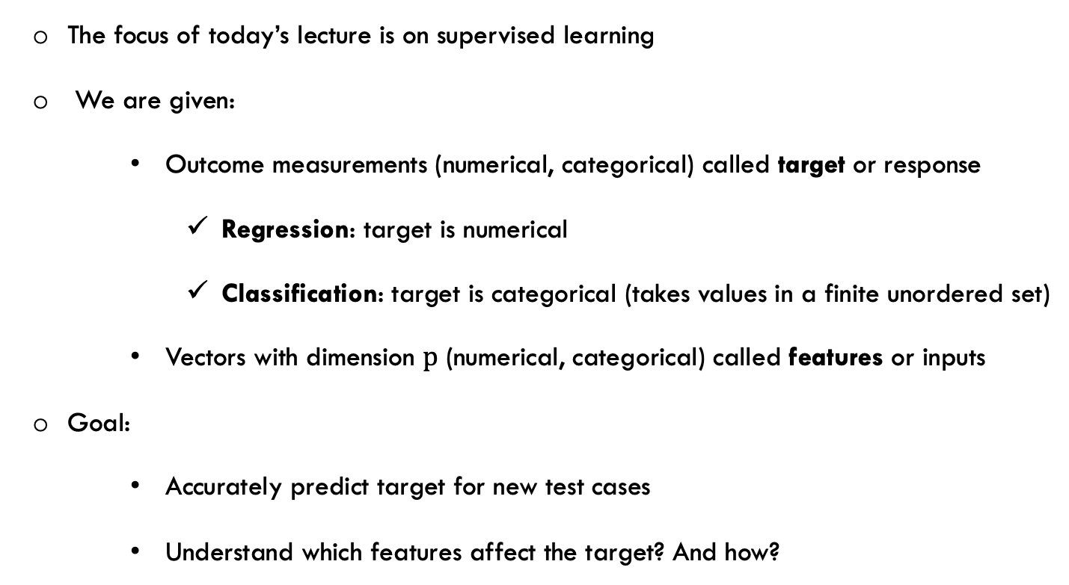
Supervised Learning
The focus of today’s lecture is on supervised learning
We are given:
Outcome measurements (numerical, categorical) called target or response
Regression: target is numerical
Classification: target is categorical (takes values in a finite unordered set)
Vectors with dimension $p$ (numerical, categorical) called features or inputs
Goal:
Accurately predict target for new test cases
Understand which features affect the target? And how?

Slide 8
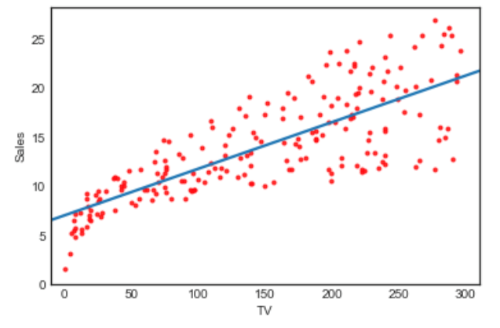
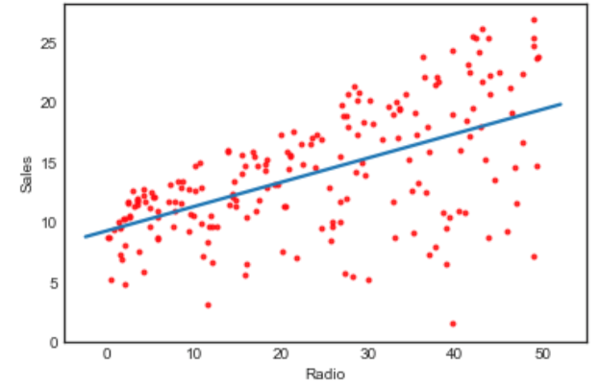
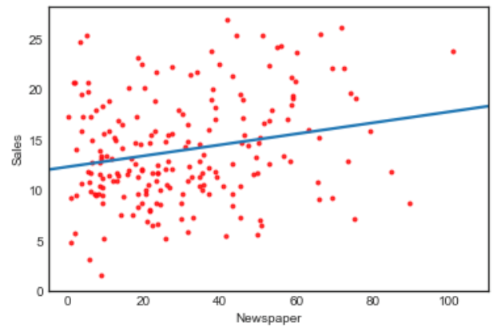
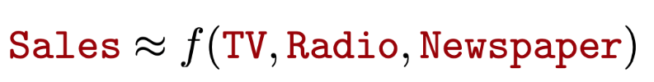
Supervised Learning Example
The graphs depict the relationship between the Sales of company and its advertising methods
TV
Radio
Newspaper
Question: Can we predict the sales using advertising method values individually?
The blue lines depict linear regression lines
How about if we use all of the variables at the same time?
Source: A Introduction to Statistical Learning with Application in R, Trever Hastie and Rob Tibshirani

Slide 9

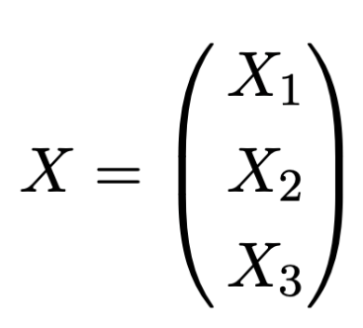
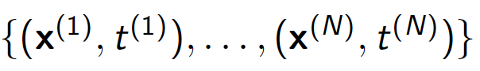
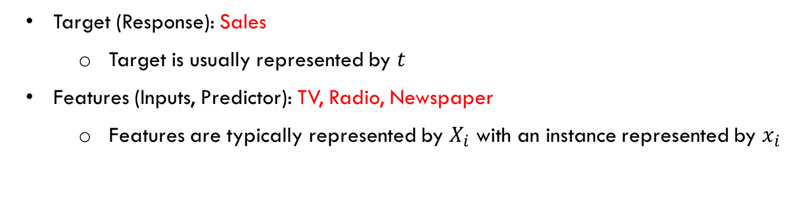
Supervised Learning Model
Target (Response): Sales
Target is usually represented by $t$
Features (Inputs, Predictor): TV, Radio, Newspaper
Features are typically represented by $X_{i}$ with an instance represented by $x_{i}$
The training set is represented by

Slide 10
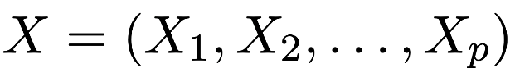
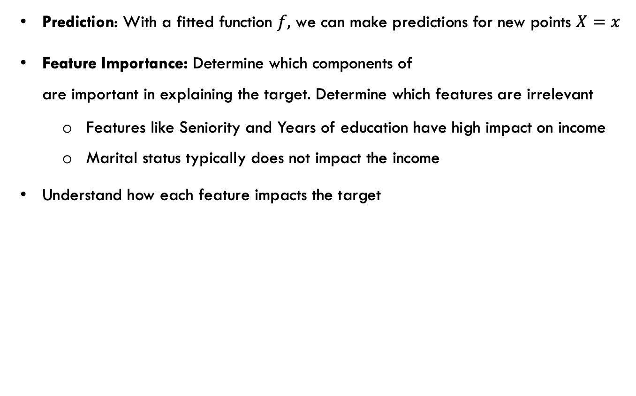
Supervised Learning Model
Prediction: With a fitted function $f,$ we can make predictions for new points $X=x$
Feature Importance: Determine which components of are important in explaining the target$.$ Determine which features are irrelevant
Features like Seniority and Years of education have high impact on income
Marital status typically does not impact the income
Understand how each feature impacts the target

Slide 11
Classification example
The following inputs with their associated label (color) are given to us

Slide 12
Classification example
How do we classify A, B and C?
A
C
B

Slide 13
Classification example
How about finding the closest point to the test point (A, B, C) and use it
as the color prediction for the test point?
A
C
B

Slide 14
Nearest Neighbor Classifier
Based on nearest neighbor, we classify
A: Red B: Blue C: Blue
A
C
B

Slide 15
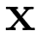
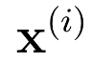
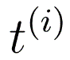
1-Nearest Neighbor Classifier
Training examples are
Targets are categories {Spam, Not Spam}
The simplest idea is to find the closest training point (only 1 point) to it and use its label to classify the new point (1-NN)
Any machine learning algorithm has two steps: training, prediction
Learning Step: Just store all the training examples
Prediction Step: For a new data point
Find the training example in the training set, that is closest to
Predict its label to the label associated with

Slide 16
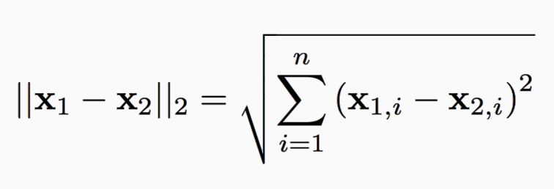
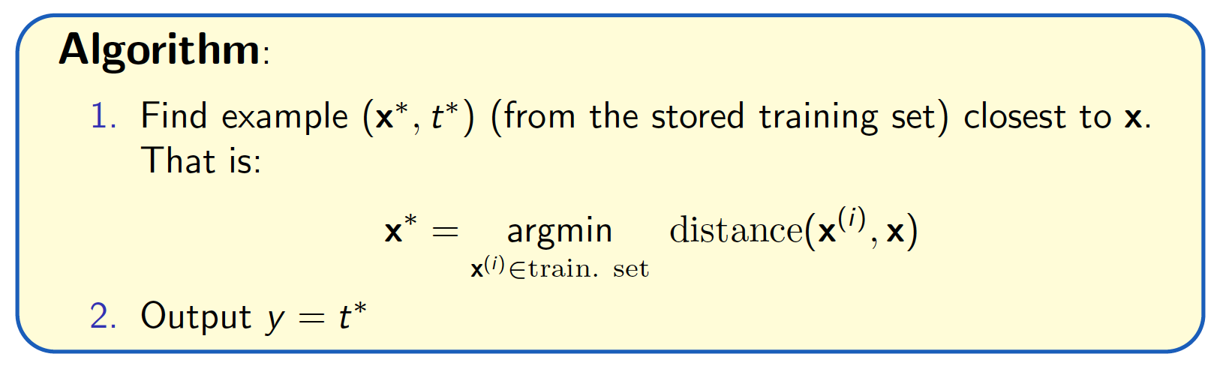
1-Nearest Neighbor Classifier
For formal definition of “nearest”/”closest”, we can use Euclidean distance
Source: Slide credit: R grosse

Slide 17
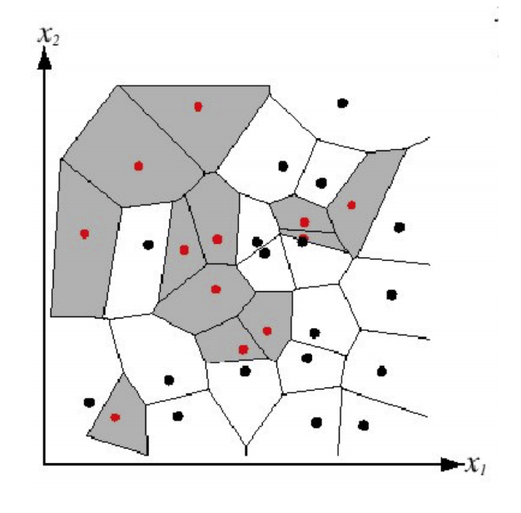
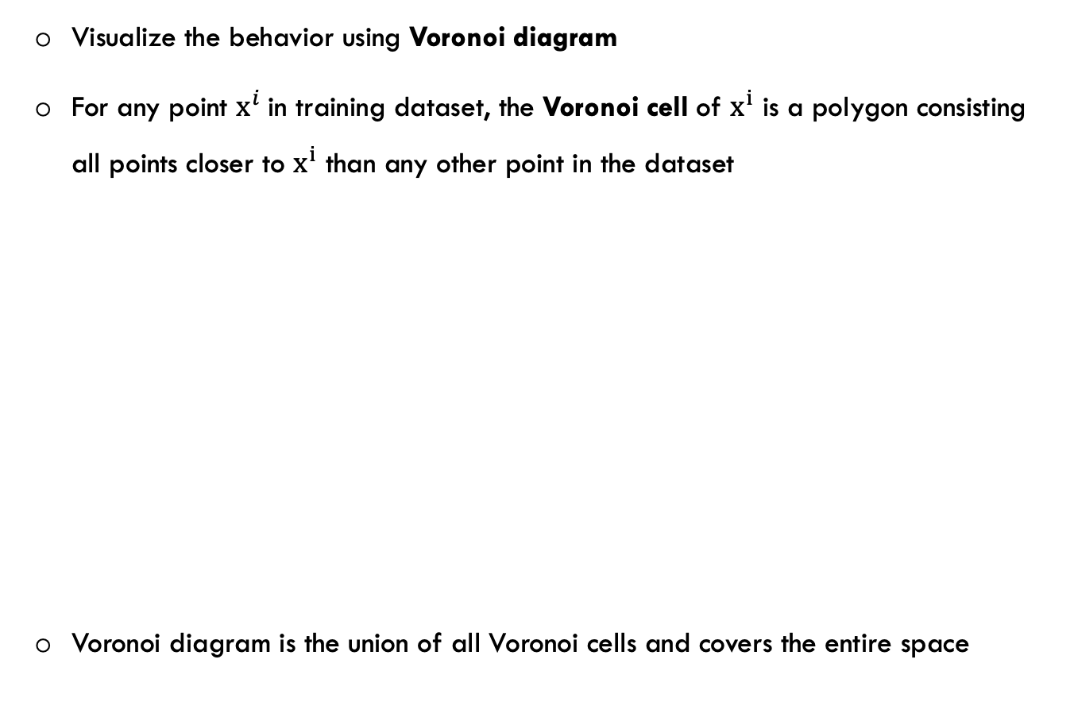
Voronoi Diagram
Visualize the behavior using Voronoi diagram
For any point $x^{i}$in training dataset, the Voronoi cell of $x^{i}$ is a polygon consisting all points closer to $x^{i}$ than any other point in the dataset
Voronoi diagram is the union of all Voronoi cells and covers the entire space
Source: Slide credit: R grosse

Slide 18
Decision Boundary
Decision Boundary: The boundary between regions of input space assigned to different categories

Slide 19
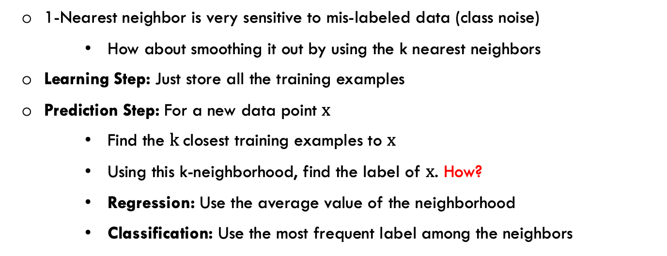
k-Nearest Neighbor Classifier
1-Nearest neighbor is very sensitive to mis-labeled data (class noise)
How about smoothing it out by using the k nearest neighbors
Learning Step: Just store all the training examples
Prediction Step: For a new data point $x$
Find the $k$closest training examples to $x$
Using this k-neighborhood, find the label of $x$. How?
Regression: Use the average value of the neighborhood
Classification: Use the most frequent label among the neighbors

Slide 20
Instance Based Learning
Nearest Neighbor is a subclass of more general learning techniques called Instance Based Learning
Simplest class of learning methods
Learning: Store labeled examples
Prediction: Given a new point, classify it using similar stored examples
Simple methods for approximating discrete and real valued target functions
It is based on the assumption that output (label) varies smoothly with input (features)
They are called lazy learners, because most of the computation is done at prediction time

Slide 21
Instance Based Learning
Advantages:
Training is very fast
Store the training data (adding labeled instances to a list)
Can learn very complex functions
Training data is always accessible
Disadvantages:
Need a lot of storage
Prediction is very slow. And it gets slower with more training data
Irrelevant features can impact its accuracy

Slide 22
k Nearest Neighbors: Issues and Remedies
Some features have larger scales, and are treated as more important
Data normalization is needed
Irrelevant, correlated features add noise to distance measure
Eliminate some of the features/Create new uncorrelated ones
How about Non-numeric features Hamming distance
Need to calculate the distance to the test point from each of the stored ones
Brute-force Very slow
Use subset of dimensions, Use subset of examples
Remove examples that lie within a region
Use efficient search tree (kd-tree), use Hashing,…

Slide 23
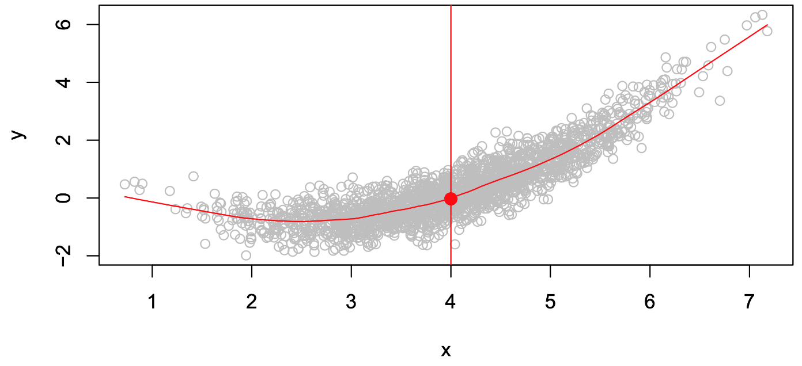
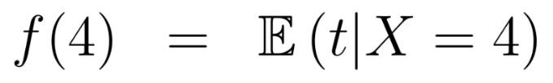
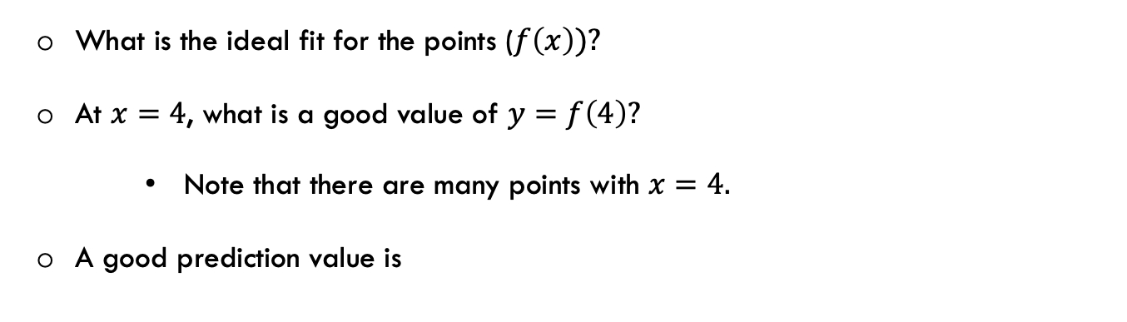
Nearest Neighbor Regression
What is the ideal fit for the points ($f\left(x\right))?$
At $x=4$, what is a good value of $y=f\left(4\right)?$
Note that there are many points with $x=4.$
A good prediction value is
Source: A Introduction to Statistical Learning with Application in R, Trever Hastie and Rob Tibshirani

Slide 24
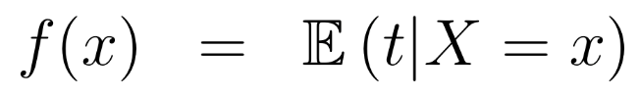
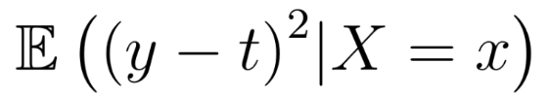
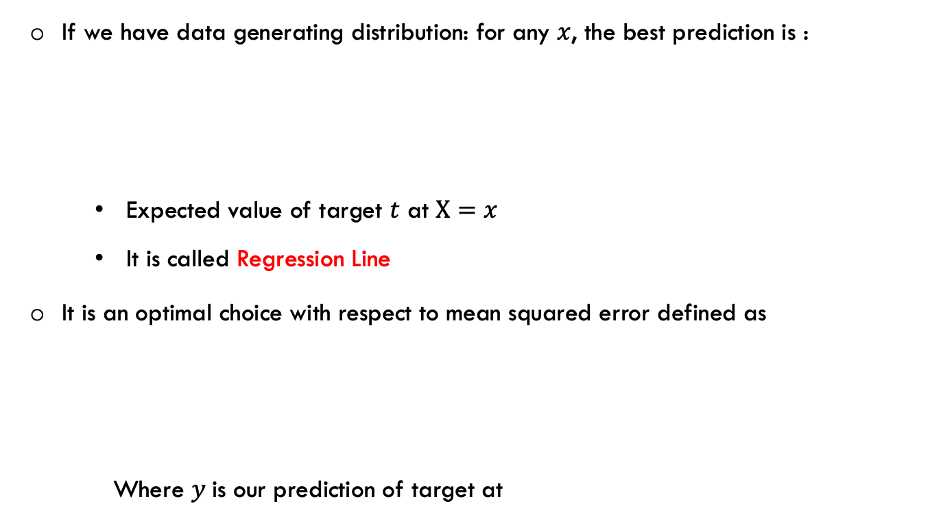
Nearest Neighbor Regression
If we have data generating distribution: for any $x$, the best prediction is :
Expected value of target $t$ at $X=x$
It is called Regression Line
It is an optimal choice with respect to mean squared error defined as
Where $y$is our prediction of target at

Slide 25
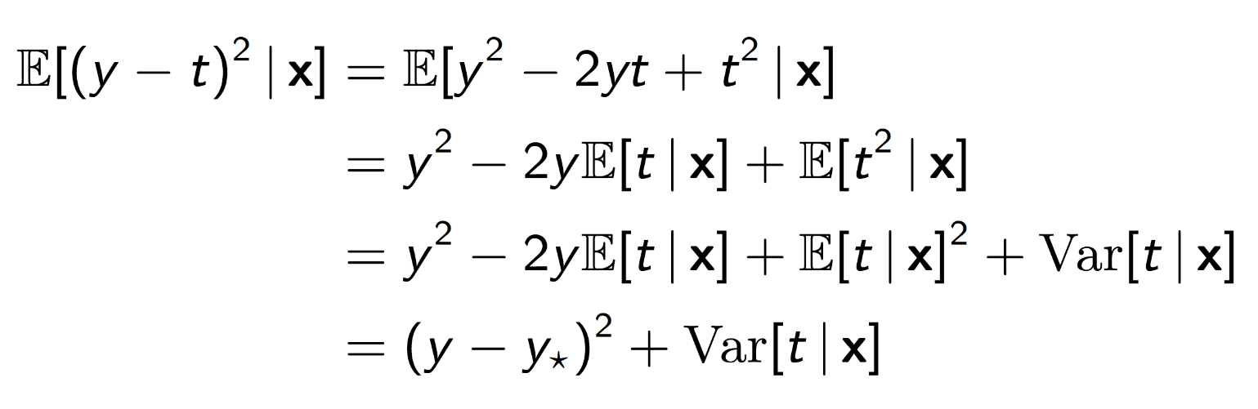
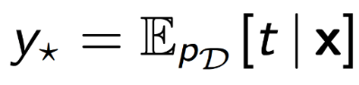
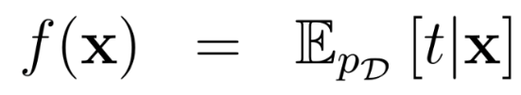
Nearest Neighbor Regression
Proof:
Bayes Error: The best error we can achieve. It does not depend on our model. It only depends on the data itself
In the formula above:
To minimize the error, assuming we know the data generating distribution, the best choice is
Source: Slide credit: R grosse

Slide 26
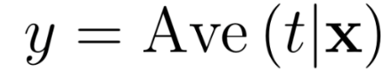
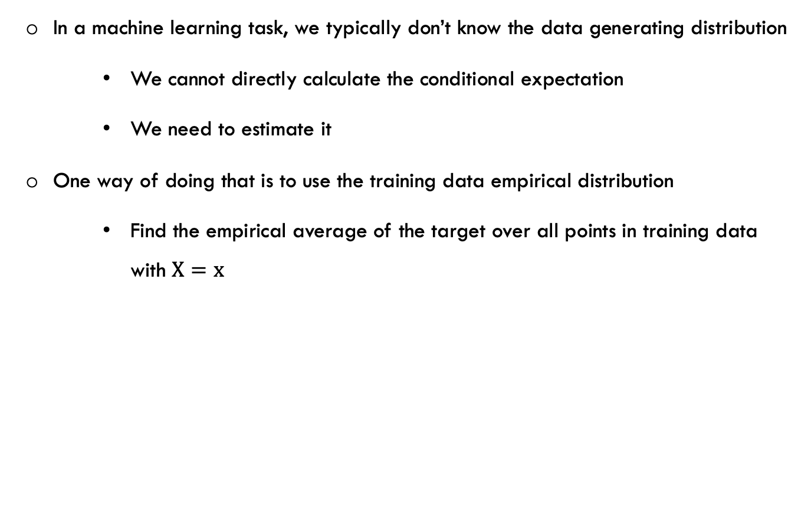
Nearest Neighbor Regression
In a machine learning task, we typically don’t know the data generating distribution
We cannot directly calculate the conditional expectation
We need to estimate it
One way of doing that is to use the training data empirical distribution
Find the empirical average of the target over all points in training data with $X=x$

Slide 27
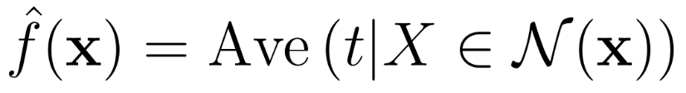
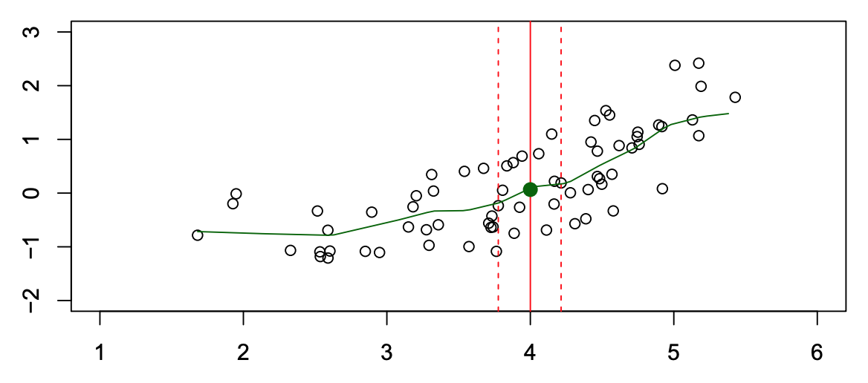
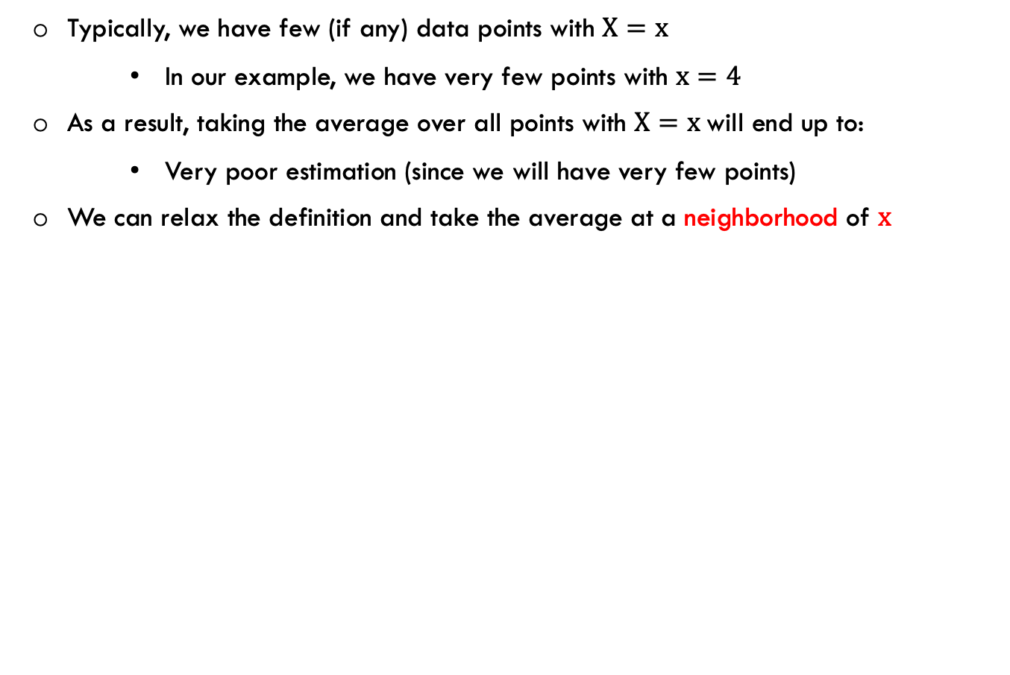
Nearest Neighbor Estimation
Typically, we have few (if any) data points with $X=x$
In our example, we have very few points with $x=4$
As a result, taking the average over all points with $X=x$will end up to:
Very poor estimation (since we will have very few points)
We can relax the definition and take the average at a neighborhood of $x$
Source: A Introduction to Statistical Learning with Application in R, Trever Hastie and Rob Tibshirani

Slide 28
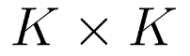
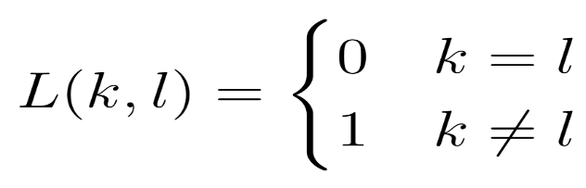
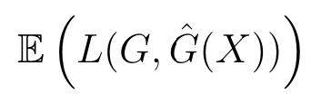
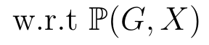
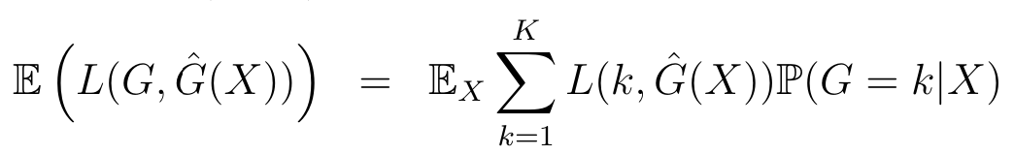
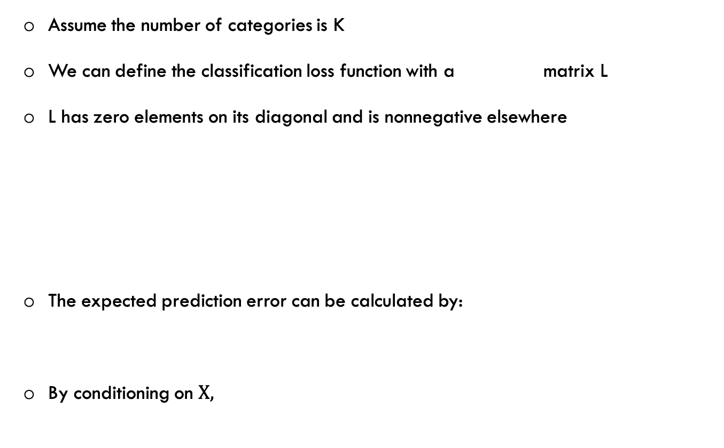
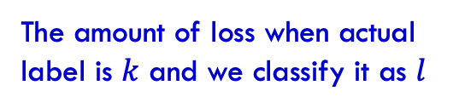
Nearest Neighbor Classification
Assume the number of categories is K
We can define the classification loss function with a matrix L
L has zero elements on its diagonal and is nonnegative elsewhere
The expected prediction error can be calculated by:
By conditioning on $X,$
The amount of loss when actual label is $k$ and we classify it as $l$
Source: A Introduction to Statistical Learning with Application in R, Trever Hastie and Rob Tibshirani

Slide 29
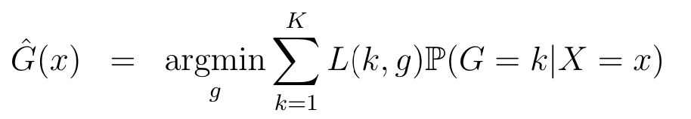
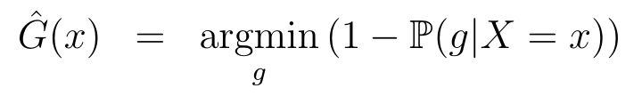
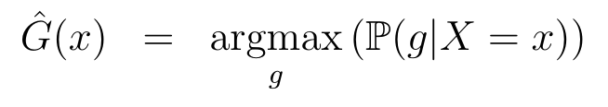
Nearest Neighbor Classification
It suffices to minimize the expected probability of error pointwise:
With 0-1 loss, it simplifies to:
Which is equivalent to:
This is called Bayes Classifier
It classifies the instance to the most probable class
Since we don’t know exact distribution, we approximate it with the majority vote in the neighborhood (empirical distribution)
Source: A Introduction to Statistical Learning with Application in R, Trever Hastie and Rob Tibshirani

Slide 30
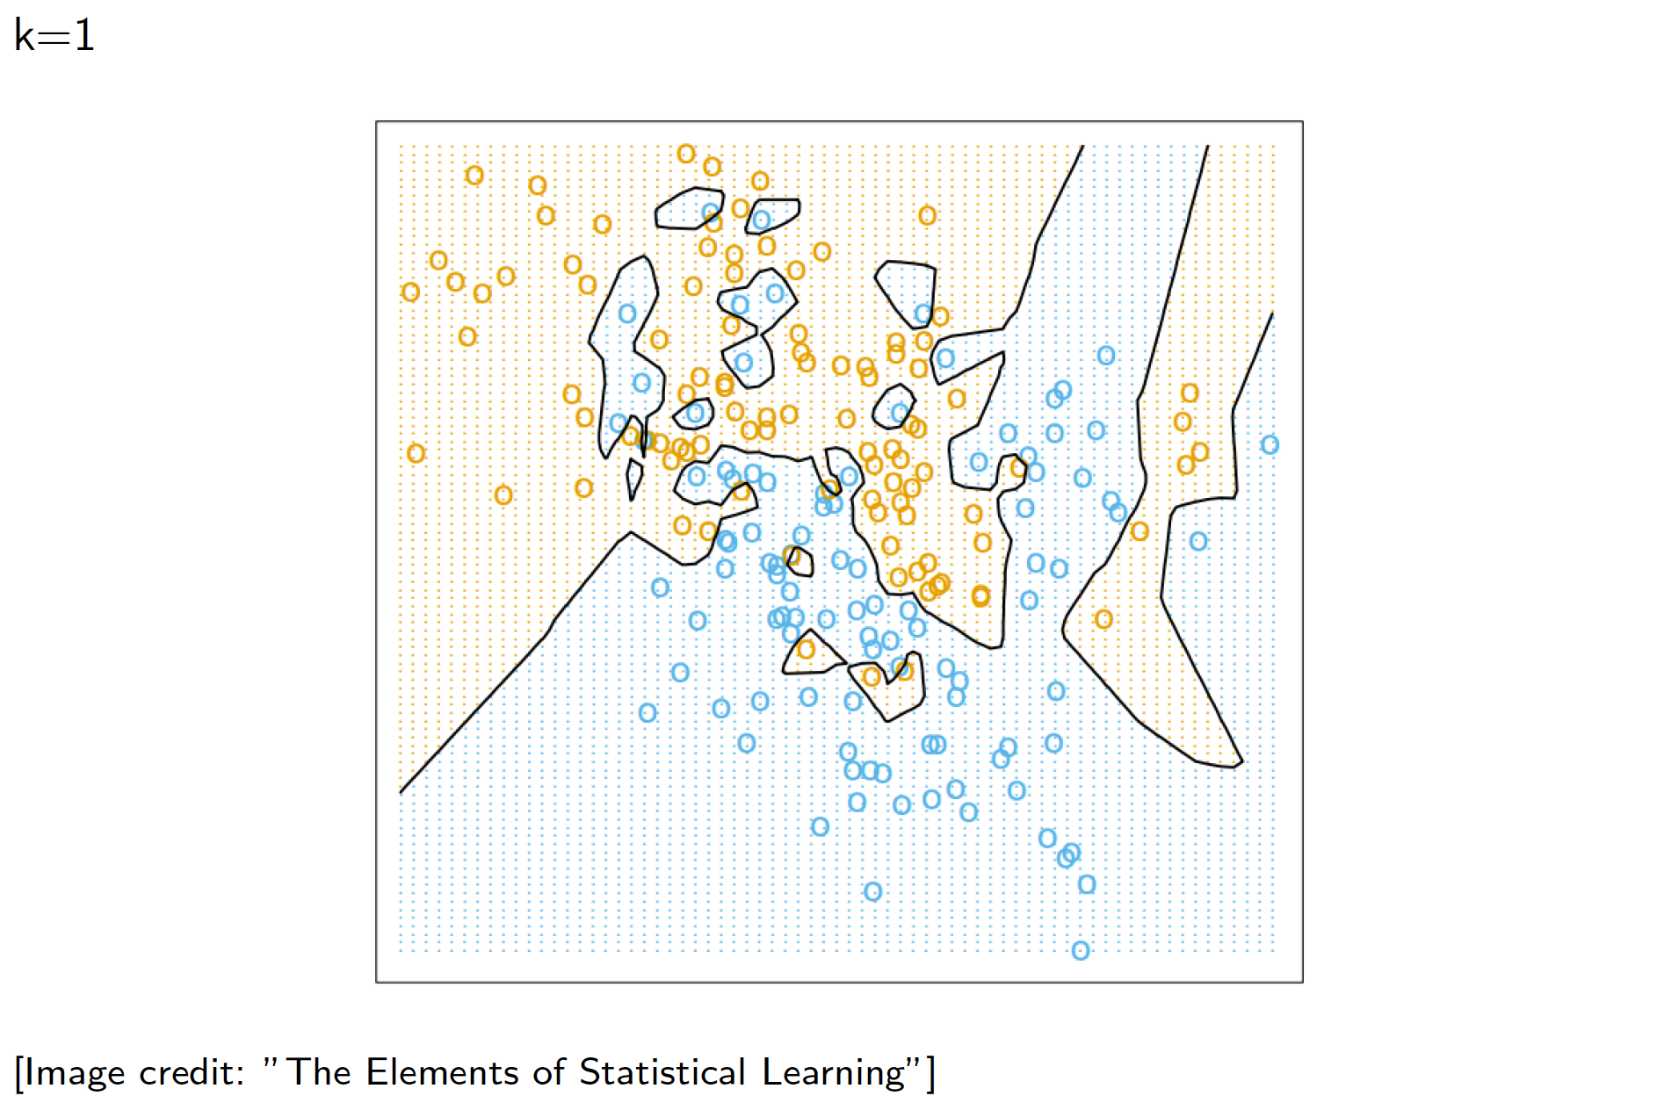
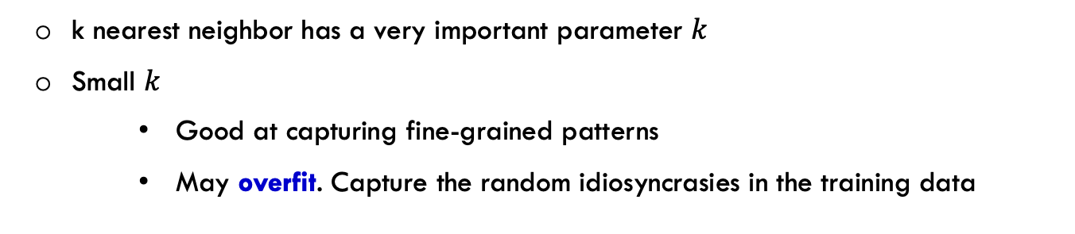
Nearest Neighbors: how to choose k?
k nearest neighbor has a very important parameter $k$
Small $k$
Good at capturing fine-grained patterns
May overfit. Capture the random idiosyncrasies in the training data

Slide 31
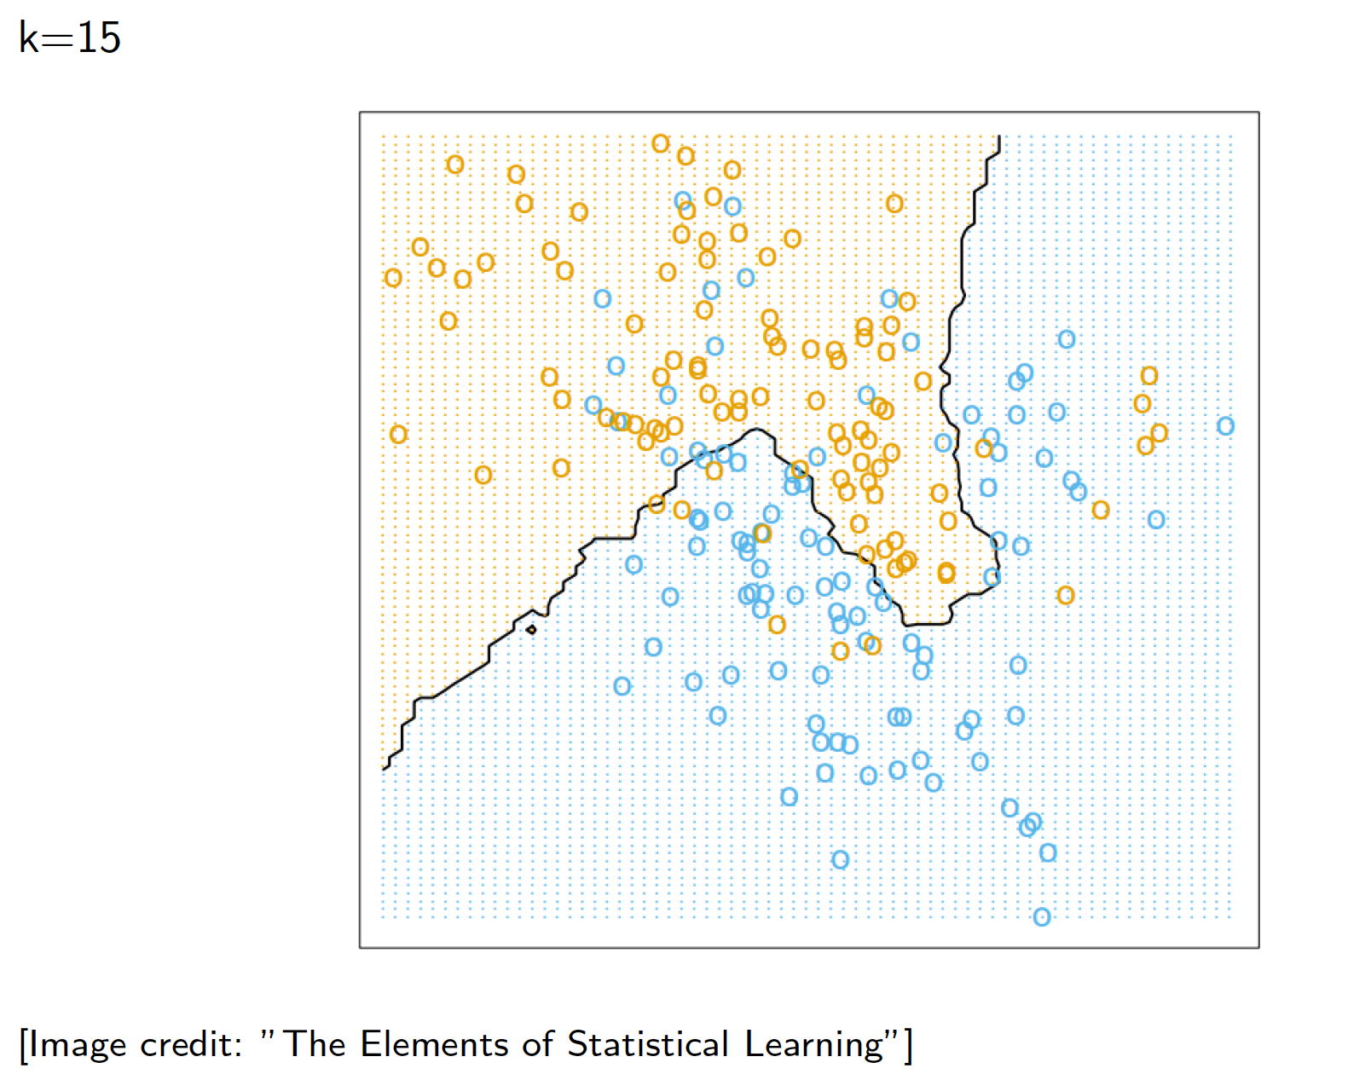
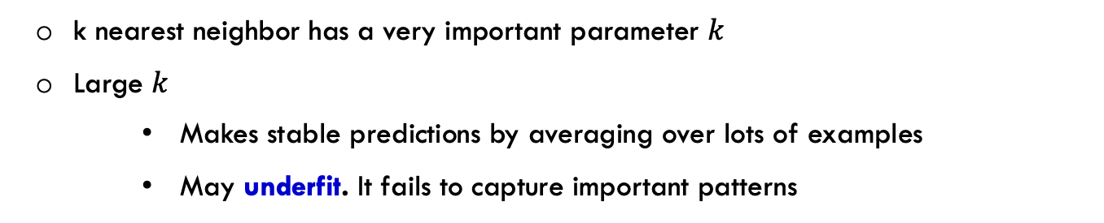
Nearest Neighbors: how to choose k?
k nearest neighbor has a very important parameter $k$
Large $k$
Makes stable predictions by averaging over lots of examples
May underfit. It fails to capture important patterns

Slide 32
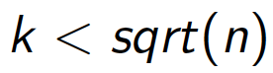
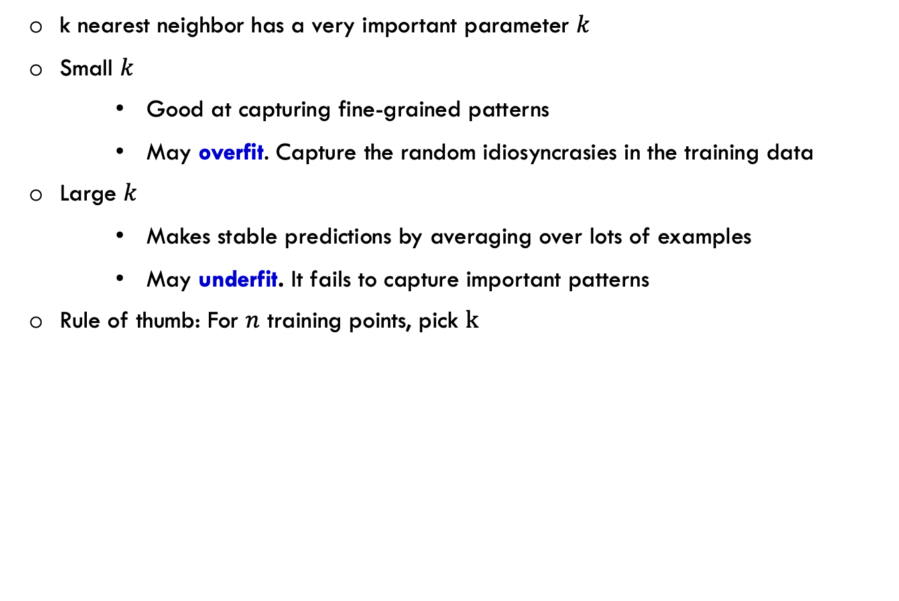
Nearest Neighbors: how to choose k?
k nearest neighbor has a very important parameter $k$
Small $k$
Good at capturing fine-grained patterns
May overfit. Capture the random idiosyncrasies in the training data
Large $k$
Makes stable predictions by averaging over lots of examples
May underfit. It fails to capture important patterns
Rule of thumb: For $n$ training points, pick $k$

Slide 33
k Nearest Neighbor in Practice
In practice, we use an odd k. Why?
To break ties
Data Preprocessing : feature normalization is very important
You might end up with very poor model if you don’t normalize the data
Variants:
We can weight the neighbor’s label by their distance
Kernel methods
How to choose k?
Use a held-out set or cross validation

Slide 34

Evaluating a prediction function
How do we evaluate performance of a machine learning model?
A loss function scores how far off a prediction is from desired target
L(prediction, target) returns a non-negative value
A good learning model has a small loss, or equivalently minor error
Some examples of loss function:
Regression: squared error loss ${=\left(prediction−target\right)}^{2}$
Classification: 0/1 loss
Source: David Rosenberg, Foundations of Machine learning, Bloomberg ML EDU

Slide 35

Evaluating a prediction function
How do we evaluate performance of a machine learning model?
A loss function scores how far off a prediction is from desired target
L(prediction, target) returns a non-negative value
A good learning model has a small loss, or equivalently minor error
Some examples of loss function:
Regression: squared error loss ${=\left(prediction−target\right)}^{2}$
Classification: 0/1 loss
A model is given to us and has a 1% error rate. We are okay with error rate under 2%
Should we accept this model?
No. a good model must perform well on some data it hasn’t seen before
Do not test a person with problems they have seen before
Source: David Rosenberg, Foundations of Machine learning, Bloomberg ML EDU

Slide 36
Test set
A test set is labeled data that is independent of training data
Split data randomly into 80% training and 20% test
Training set is only used for training the model
Test set is used for assessing its performance
Sklearn library has a lot of functionality for train/test splitting
Train/Test size trade-off:
A larger test set give more accurate assessment of performance
A larger training set helps the algorithm to learn better
A large part of real-world machine learning is ensuring that
Test performance is a good representative of deployment performance
Ideally, train and test data should have a similar distribution
How about splitting the train/test sets randomly
Usually, it is a good approach
How about financial time series? Does it work for time series?
Source: David Rosenberg, Foundations of Machine learning, Bloomberg ML EDU

Slide 37
Model performance
How should I evaluate your project (trained model)?
Split data into train/test
Give the training data to you, and let you come up with a prediction model
I apply your prediction model on test data
I should split the data in a way that the test performance is a good estimate of deployment performance
Source: David Rosenberg, Foundations of Machine learning, Bloomberg ML EDU

Slide 38
Model performance
How should I evaluate your project (trained model)?
Split data into train/test
Give the training data to you, and let you come up with a prediction model
I apply your prediction model on test data
I should split the data in a way that the test performance is a good estimate of deployment performance
As a student you want to try many different fancy ML models
Each of which gives you a prediction function
You still need to make sure your model does well in real life (or my test set)
You need a test set to evaluate your prediction function
Split the data that is given to you into train/validation sets
Validation set is like a test set, but it is used to choose the best among many prediction functions
Original test set is used to evaluate the final chosen prediction function
Source: David Rosenberg, Foundations of Machine learning, Bloomberg ML EDU

Slide 39


Polynomial curve fitting example
Polynomial curve fitting is a simple example of linear regression
Basically, some data is given to us and we are asked to find its best polynomial fit
A learning algorithm finds the best parameters $w_{0},w_{1},…w_{M}$ that fits the data the best
But we don’t know the degree of the polynomial in advance
We need to let the data decide about it
But, if the goal is minimizing training error, then the degree polynomial is selected to be $n−1$
Here, $M$ is a hyper parameter
Almost every ML algorithm has at least one hyper parameter
Loss function, model complexity, regularization type, learning rate, …
The hyper parameters are optimized using the validation set
You should train many models with different hyper parameters, and select the one that performs the best on validation data
Source: David Rosenberg, Foundations of Machine learning, Bloomberg ML EDU

Slide 40




Polynomial curve fitting

Slide 41


Underfitting/Overfitting
Model is too simple, and does not fit the data well ( Underfitting)
Model is too complex, it fits the data perfectly, but does not generalize well (Overfitting)

Slide 42


Hyper Parameter Optimization
$k$ is a hyper parameter and we cannot fit it as part of the learning algorithm
Use validation set to find the hyper parameter
The test set is used only at the very end, to measure the generalization
performance of the final configuration
Source: Slide credit: R grosse

Slide 43
k-Fold cross validation
Assume the test set is too small for good performance estimate.
In this case, we use k-fold cross validation
Source: David Rosenberg, Foundations of Machine learning, Bloomberg ML EDU
Source: Provost and Fawcett, Data science for business, figure 5-9

Slide 44


k-Fold cross validation
Assume the test set is too small for good performance estimate.
In this case, we use k-fold cross validation
Randomly partition training data $D$ into k folds of equal size $D_{1},D_{2},…,D_{k}$
Source: David Rosenberg, Foundations of Machine learning, Bloomberg ML EDU
Source: Provost and Fawcett, Data science for business, figure 5-9

Slide 45


k-Fold cross validation
Assume the test set is too small for good performance estimate.
In this case, we use k-fold cross validation
Randomly partition training data $D$ into k folds of equal size $D_{1},D_{2},…,D_{k}$
$for i=1,…k:$
Train model $M_{i}$ on $D−D_{i}$
Let $T_{i}$ be $M_{i}$ performance on $D_{i}$
Source: David Rosenberg, Foundations of Machine learning, Bloomberg ML EDU
Source: Provost and Fawcett, Data science for business, figure 5-9

Slide 46
k-Fold cross validation
Assume the test set is too small for good performance estimate.
In this case, we use k-fold cross validation
Randomly partition training data $D$ into k folds of equal size $D_{1},D_{2},…,D_{k}$
$for i=1,…k:$
Train model $M_{i}$ on $D−D_{i}$
Let $T_{i}$ be $M_{i}$ performance on $D_{i}$
Source: David Rosenberg, Foundations of Machine learning, Bloomberg ML EDU
Source: Provost and Fawcett, Data science for business, figure 5-9

Slide 47
k-Fold cross validation
Assume the test set is too small for good performance estimate.
In this case, we use k-fold cross validation
Randomly partition training data $D$ into k folds of equal size $D_{1},D_{2},…,D_{k}$
$for i=1,…k:$
Train model $M_{i}$ on $D−D_{i}$
Let $T_{i}$ be $M_{i}$ performance on $D_{i}$
Source: David Rosenberg, Foundations of Machine learning, Bloomberg ML EDU
Source: Provost and Fawcett, Data science for business, figure 5-9

Slide 48
k-Fold cross validation
Assume the test set is too small for good performance estimate.
In this case, we use k-fold cross validation
Randomly partition training data $D$ into k folds of equal size $D_{1},D_{2},…,D_{k}$
$for i=1,…k:$
Train model $M_{i}$ on $D−D_{i}$
Let $T_{i}$ be $M_{i}$ performance on $D_{i}$
Source: David Rosenberg, Foundations of Machine learning, Bloomberg ML EDU
Source: Provost and Fawcett, Data science for business, figure 5-9

Slide 49
k-Fold cross validation
Assume the test set is too small for good performance estimate.
In this case, we use k-fold cross validation
Randomly partition training data $D$ into k folds of equal size $D_{1},D_{2},…,D_{k}$
$for i=1,…k:$
Train model $M_{i}$ on $D−D_{i}$
Let $T_{i}$ be $M_{i}$ performance on $D_{i}$
Source: David Rosenberg, Foundations of Machine learning, Bloomberg ML EDU
Source: Provost and Fawcett, Data science for business, figure 5-9

Slide 50

k-Fold cross validation
Assume the test set is too small for good performance estimate.
In this case, we use k-fold cross validation
Randomly partition training data $D$ into k folds of equal size $D_{1},D_{2},…,D_{k}$
$for i=1,…k:$
Train model $M_{i}$ on $D−D_{i}$
Let $T_{i}$ be $M_{i}$ performance on $D_{i}$
Report the mean and standard deviation of $T_{i}$s
Source: David Rosenberg, Foundations of Machine learning, Bloomberg ML EDU
Source: Provost and Fawcett, Data science for business, figure 5-9

Slide 51

Time series model evaluation
Random splitting may cause issues for time series
Some test periods may happen before training periods
Suppose the time-series changes slowly over time
To predict at test day $d$, just predict value at training day closest to it in time
Source: David Rosenberg, Foundations of Machine learning, Bloomberg ML EDU
Source: https://stats.stackexchange.com/users/123886/jatin-garg, https://stats.stackexchange.com/q/268847

Slide 52

Time series model evaluation
Random splitting may cause issues for time series
Some test periods may happen before training periods
Suppose the time-series changes slowly over time
To predict at test day $d$, just predict value at training day closest to it in time
Create split, by splitting in time, train is everything before day $d,$ and test is afterward
Source: David Rosenberg, Foundations of Machine learning, Bloomberg ML EDU
Source: https://stats.stackexchange.com/users/123886/jatin-garg, https://stats.stackexchange.com/q/268847

Slide 53


Time series model evaluation
Random splitting may cause issues for time series
Some test periods may happen before training periods
Suppose the time-series changes slowly over time
To predict at test day $d$, just predict value at training day closest to it in time
Create split, by splitting in time, train is everything before day $d,$ and test is afterward
Similarly, for cross-validation
Source: David Rosenberg, Foundations of Machine learning, Bloomberg ML EDU
Source: https://stats.stackexchange.com/users/123886/jatin-garg, https://stats.stackexchange.com/q/268847

Slide 54

Curse of Dimensionality
In low dimension space $(p≤4)$, Nearest neighbor is a pretty good estimation
Methods that work in low dimensional spaces might fail in higher dimensions
If some of the features are irrelevant, for sure it will hurt the model accuracy
But even in case of all relevant features, high dimensional space behave oddly
Low-dimensional visualizations are misleading! In high dimensions, most points are far apart.
Nearest neighbors can be very far from the actual estimation point
This is called curse of dimensionality

Slide 55

Curse of Dimensionality- Example 1
What fraction of the points in a square lie outside the circle inscribed in it?
Source: A Introduction to Statistical Learning with Application in R, Trever Hastie and Rob Tibshirani

Slide 56


Curse of Dimensionality- Example 1
What fraction of the points in a square lie outside the circle inscribed in it?
$$\sim 20\%$$
Source: A Introduction to Statistical Learning with Application in R, Trever Hastie and Rob Tibshirani

Slide 57

Curse of Dimensionality- Example 1
What fraction of the points in a cube lie outside the sphere inscribed in it?
Source: A Introduction to Statistical Learning with Application in R, Trever Hastie and Rob Tibshirani

Slide 58


Curse of Dimensionality- Example 1
What fraction of the points in a cube lie outside the sphere inscribed in it?
$$\sim 50\%$$
Source: A Introduction to Statistical Learning with Application in R, Trever Hastie and Rob Tibshirani

Slide 59
Curse of Dimensionality- Example 1
What fraction of the points in a cube lie outside the sphere inscribed in it?
As the dimensionality increases, this fraction approaches 1
$$\sim 50\%$$
Source: A Introduction to Statistical Learning with Application in R, Trever Hastie and Rob Tibshirani

Slide 60
Curse of Dimensionality- Example 1
What fraction of the points in a cube lie outside the sphere inscribed in it?
As the dimensionality increases, this fraction approaches 1
In high dimensions, most of the points are far from the center
$$\sim 50\%$$
Source: A Introduction to Statistical Learning with Application in R, Trever Hastie and Rob Tibshirani

Slide 61


Curse of Dimensionality- Example 2
What fraction of the points in a unit circle lies between radius $1−ε and 1$?
Source: A Introduction to Statistical Learning with Application in R, Trever Hastie and Rob Tibshirani

Slide 62



Curse of Dimensionality- Example 2
What fraction of the points in a unit circle lies between radius $1−ε and 1$?
In $d$ dimensions, the fraction is
For very large d, it approaches 100%
Source: A Introduction to Statistical Learning with Application in R, Trever Hastie and Rob Tibshirani

Slide 63

Nearest Neighbor Estimation
We need to take the average over a reasonable fraction of points to bring the variance down
In higher dimensions, a 10% neighborhood is no longer local neighborhood of the estimation point
Source: A Introduction to Statistical Learning with Application in R, Trever Hastie and Rob Tibshirani

